Slide 2
Getting started with PnP JS
Harsha Vardhini

Slide 3




Harsha Vardhini
Senior SharePoint Developer
Split~Vision
Speaker Bio (Optional)
Email
https://www.linkedin.com/in/harshavardhinii/
@harshagracy
Facebook handler

Slide 4
PnP JS
PnP Reusable controls (React)
PnP Reusable property pane controls (React)

Slide 5
PnP JS

Slide 6
PnP JS
Fluent API
SharePoint and Office 365 REST APIs
Type-safe
Very simple to configure and use
Removes the complexity of some operations
Easy to batch requests
Multiple packages, only install what’s required
SharePoint Framework, Node.js, or JavaScript projects
Open source

Slide 7
Packages - @pnp/
common
Provides shared functionality across all pnp libraries
config-store
Provides a way to manage configuration within your application
graph
Provides a fluent api for working with Microsoft Graph
logging
Light-weight, subscribable logging framework
nodejs
Provides functionality enabling the @pnp libraries within nodejs
odata
Provides shared odata functionality and base classes
Adaljsclient
Provides shared functionality across all pnp libraries
sp
Provides a fluent api for working with SharePoint REST
sp-addinhelpers
Provides functionality for working within SharePoint add-ins

Slide 8
Get item using Rest API -Ajax method
jQuery.ajax({
url: "http://<site url>/_api/web/lists/GetByTitle('Test')",
method: "GET",
headers: {
"Accept": "application/json; odata=verbose",
"content-type": "application/json;odata=verbose",
},
success: function (data) {
console.log(data);
},
error: function (data) {
console.log(data);
}
});

Slide 9
Create item using Rest API -Ajax method
jQuery.ajax({
url: "http://<site url>/_api/web/lists/GetByTitle('Test')",
type: "POST",
data: JSON.stringify({ '__metadata': { 'type': 'SP.List' }, 'Title': 'New title' }),
headers: {
"X-HTTP-Method": "MERGE",
"accept": "application/json;odata=verbose",
"content-type": "application/json;odata=verbose",
"content-length": <length of post body>,
"X-RequestDigest": $("#__REQUESTDIGEST").val(),
"IF-MATCH": "*"
},
success: doSuccess,
error: doError
});

Slide 10
Delete item using Rest API -Ajax method
jQuery.ajax({
url: "http://<site url>/_api/web/lists/GetByTitle('Test')/items(" + myID + ")",
type: "POST",
contentType: "application/json;odata=verbose",
headers: {
"Accept": "application/json;odata=verbose",
"X-RequestDigest": $("#__REQUESTDIGEST").val(),
"IF-MATCH": "*",
"X-HTTP-Method": "DELETE",
},
success: function (data) {
alert("success"); },
error: function (data) {
alert("failed"); }
});

Slide 11
Update item using Rest API -Ajax method
jQuery.ajax({
url: "http://<site url>/_api/web/lists/GetByTitle('Announcement')/items(1)",
type: "POST",
data: JSON.stringify({ '__metadata': { 'type': itemType },
'Title': 'Updated Announcement' }),
headers: {
"accept": "application/json;odata=verbose",
"content-type": "application/json;odata=verbose",
"X-RequestDigest": $("#__REQUESTDIGEST").val(),
"X-HTTP-Method": "MERGE",
"IF-MATCH": "*"
},
success: doSuccess,
error: doError
});

Slide 12
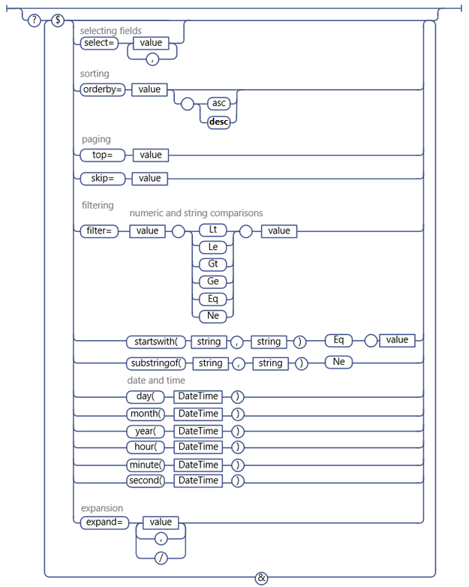

Slide 13
Get item using @pnp/sp
// get all the items from a list
sp.web.lists.getByTitle("My List").items.get().then((items: any[]) => {
console.log(items);
});
// get a specific item by id
sp.web.lists.getByTitle("My List").items.getById(1).get().then((item: any) => {
console.log(item);
});
// use odata operators for more efficient queries
sp.web.lists.getByTitle("My List").items.select("Title", "Description").top(5)
.orderBy("Modified", true).get().then((items: any[]) => {
console.log(items);
});

Slide 14
Add item using @pnp/sp
sp.web.lists.getByTitle("My List").items.add({
Title: "Title",
Description: "Description"
}).then((iar: any) => {
console.log(iar);
});
//add the content type
sp.web.lists.getById("4D5A36EA-6E84-4160-8458-65C436DB765C").items.add({
Title: "Test 1",
ContentTypeId: "0x01030058FD86C279252341AB303852303E4DAF"
});

Slide 15
Add item using @pnp/sp
sp.web.lists.getByTitle("PeopleFields").items.add({
Title: "Adding People picker",
User1Id: 9, // allows a single user
User2Id: {
results: [ 16, 45 ] // allows multiple users
}
}).then(i => {
console.log(i);
});

Slide 16
Batch Add item using @pnp/sp
let list = sp.web.lists.getByTitle("Orders");
list.getListItemEntityTypeFullName().then(entityTypeFullName => {
let batch = sp.web.createBatch();
list.items.inBatch(batch).add({ Title: "Batch 6" }, entityTypeFullName).then (b => {
console.log(b);
});
list.items.inBatch(batch).add({ Title: "Batch 7" }, entityTypeFullName).then (b => {
console.log(b);
});
batch.execute().then(d => console.log("Done"));
});

Slide 17
Update item using @pnp/sp
sp.web.lists.getByTitle("MyList").items.getById(1).update({
Title: "My New Title",
Description: "Here is a new description ",
User1Id: 9, // allows a single user
}).then(i => {
console.log(i);
});

Slide 18
Batch Update item using @pnp/sp
The ETag HTTP response header is an identifier for a specific version of a resource. It lets caches be more efficient and save bandwidth, as a web server does not need to resend a full response if the content has not changed. Additionally, etags help prevent simultaneous updates of a resource from overwriting each other.
let list = sp.web.lists.getByTitle(“Orders");
list.getListItemEntityTypeFullName().then(entityTypeFullName => {
let batch = sp.web.createBatch();
// note requirement of "*" eTag param - or use a specific eTag value as needed
list.items.getById(1).inBatch(batch).update({ Title: "Batch 6" }, "*", entityTypeFullName).
then(b => {
console.log(b);
});
list.items.getById(2).inBatch(batch).update({ Title: "Batch 7" }, "*", entityTypeFullName).
then(b => {
console.log(b);
});
batch.execute().then(d => console.log("Done"));
});

Slide 19
Delete item using @pnp/sp
let list = sp.web.lists.getByTitle("MyList");
list.items.getById(1).delete().then(deletedItem => {
console.log(deletedItem);
});

Slide 20
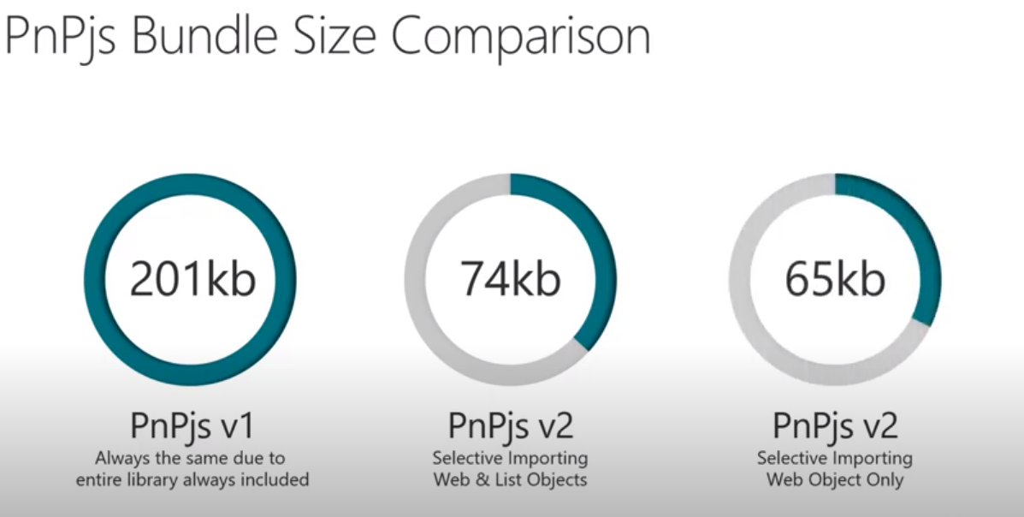
PnP JS V2 Selective imports
As the libraries have grown to support more of the SharePoint and Graph API they have also grown in size. On one hand this is good as more functionality becomes available but you had to include lots of code you didn't use if you were only doing simple operations. To solve this we introduced selective imports in v2.

Slide 21
PnP JS demo
CRUD operations

Slide 22
Accessing File Data using @PnP
sp.web.getFileByServerRelativeUrl("/sites/dev/documents/file.avi").getBlob().then((blob: Blob) => { });
sp.web.getFileByServerRelativeUrl("/sites/dev/documents/file.avi").getBuffer().then((buffer: ArrayBuffer) => { });
sp.web.getFileByServerRelativeUrl("/sites/dev/documents/file.json").getJSON().then((json: any) => { });
sp.web.getFileByServerRelativeUrl("/sites/dev/documents/file.txt").getText().then((text: string) => { });
// all of these also work from a file object no matter how you access it
sp.web.getFolderByServerRelativeUrl("/sites/dev/documents").files.getByName("file.txt").getText().then((text: string) => { });

Slide 23
Adding Attachments using @PnP
import "@pnp/sp/attachments";
let item = sp.web.lists.getByTitle("MyList").items.getById(1);
item.attachmentFiles.add("file2.txt", "Here is my content").then(v => {
console.log(v);
});
var fileInfos: any[] = []; fileInfos.push({
name: "My file name 1",
content: "string, blob, or array"
});
fileInfos.push({
name: "My file name 2",
content: "string, blob, or array"
});
sp.web.lists.getByTitle("MyList“).items.getById(2).attachmentFiles
.addMultiple(fileInfos).then(r => {
console.log(r);
});

Slide 24
Deleting Attachments using @PnP
import "@pnp/sp/attachments";
const list = sp.web.lists.getByTitle("MyList");
list.items.getById(2).attachmentFiles.deleteMultiple("1.txt","2.txt").then(r => {
console.log(r);
});

Slide 25
Reusable React controls for your SharePoint Framework solutions
https://sharepoint.github.io/sp-dev-fx-controls-react/
https://sharepoint.github.io/sp-dev-fx-property-controls/

Slide 27
Consume Graph APIs in SPFx
By Jenkins N S on 29th April 2020

